Slide 1
Welcome!
REDCap + R Workshop
R/Medicine 2024

Slide 2

Stephan
Notes:
I’m Stephan Kadauke, and I’m an Assistant Professor of Pathology and Lab Medicine at the Children’s Hospital of Philadelphia. I see patients, run a clinical lab that deals with bone marrow transplants and other cell therapies, and I run an Informatics team that builds data products for clinical, regulatory, quality, and research operations of the clinical cell therapy program here at CHOP. My team created the REDCapTidieR package.

Slide 3

Will
Notes:
Will Beasley is a Professor at Oklahoma University. He is the creator and main contributor of the REDCapR package.

Slide 4

Assumptions
You have access to a REDCap database.
You have basic knowledge of R.
You're interested in learning how to pull data out of REDCap using R, and potentially be able to push data into REDCap as well.
Notes:
… but don't necessarily have in-depth knowledge about complex databases with repeated and longitudinal instruments
… but aren't necessarily an expert in using it to clean, visualize, or model data
… Either because you’re an analyst who needs to learn how to do this, or because you’re a REDCap admin who has to deal with people who use R to interact with REDCap, and you want to be able to point them in the right direction.

Slide 5
Orientation to the Course

Slide 6
The Data Analysis Pipeline
Notes:
This in a gentle introduction to data science designed for healthcare professionals and clinical researchers who don't have a background in programming. This slide shows a high-level conceptual framework of the most important steps of the data analysis process. You always start by importing data and cleaning or "tidying" it up. Then you start an iterative process of exploratory data analysis, which usually requires some data transformation. The main engines of knowledge generation are visualization and modeling. Finally, you need to communicate your results. W
We will introduce the basics of all of these steps today, with the expection of modeling, which is the focus of Alison Hill's 201 level course.

Slide 7
Lecture slides
Notes:
We will introduce new concepts with lecture slides

Slide 8
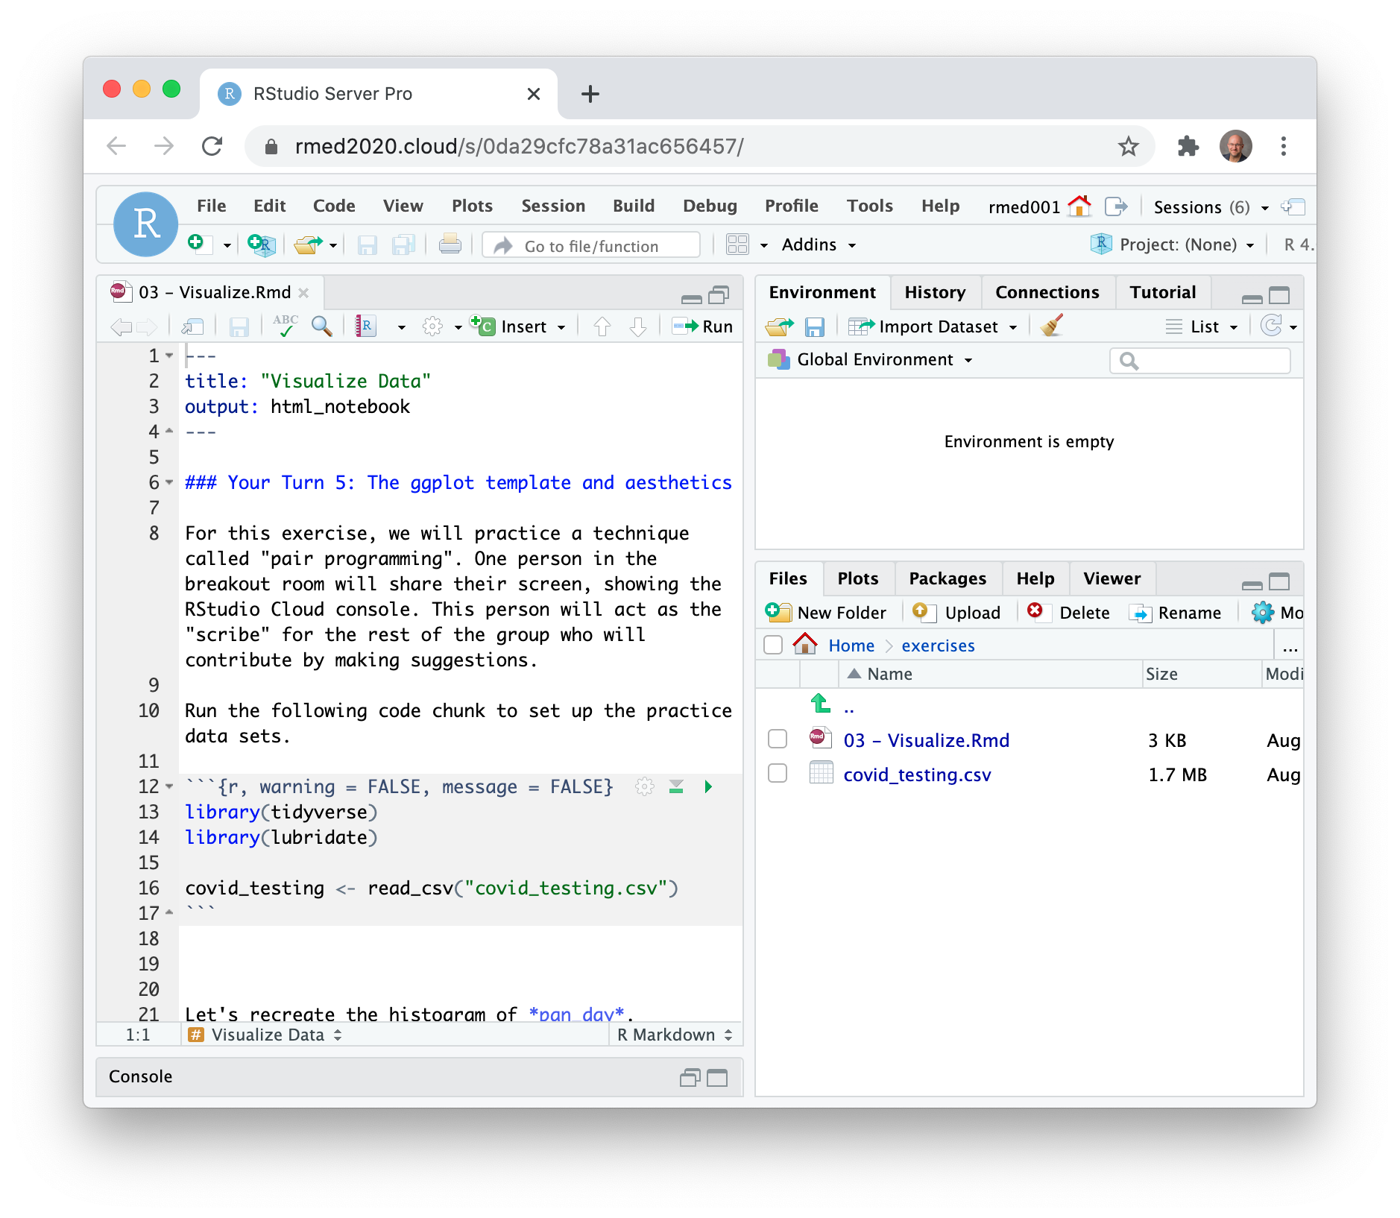
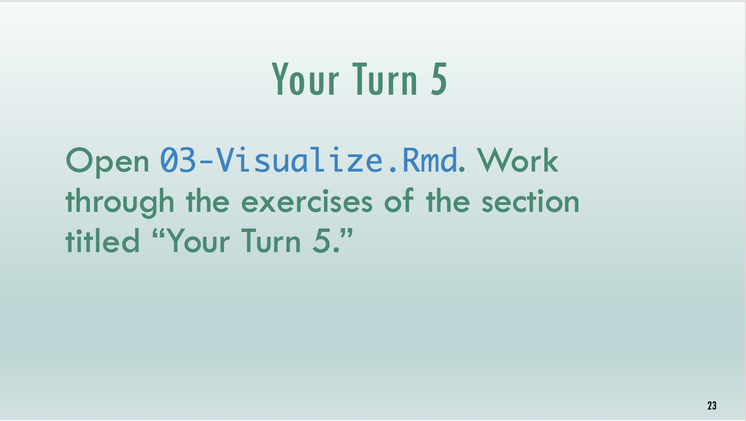
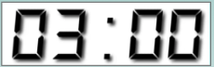
Timed interactive coding exercises
Notes:
And then practice these new skills with timed interactive coding exercises. You will work in a training environment on the web that we specifically set up for this course.
In some cases, we will walk through a tutorial written in Quarto together.
It's important to note that these exercises are timed. It's not essential that you finish each exercise, but it's essential that you try. When the time is up, we ask that everyone stop working and return to the main session. We will then live code the exercise to catch everyone up.

Slide 9
Code of Conduct
Screenshots
Recordings
Photographs
Harassment
https://events.linuxfoundation.org/r-medicine/attend/code-of-conduct/
Notes:
One more serious thing we need to point out, since this is an interactive course - we want to provide a welcoming and supportive environment for all people, regardless of background or identity.
** So we have a strict no harassment policy: this includes abusive, offensive, or degrading language, in writing or voice
** for full CoC please take a look at the main website About > Code of Conduct https://events.linuxfoundation.org/r-medicine/attend/code-of-conduct/
** Also, to respect the privacy of participants, we don’t allow screenshots, recordings, or photographs.
If we find that you violate the code of conduct you may be removed from the course.

Slide 10
Getting Onto Posit Cloud
Notes:
We’ll be using Posit Cloud to do interactive exercises for this workshop. Posit Cloud is a web version of the RStudio IDE, and we’ve set up a Posit Cloud environment specifically for this session so you don’t have to download or install anything on your computer.
However, after the course we highly recommend you download the RStudio IDE from the Posit website. You can find some guidance on how to do this on Mac or Windows on the course website.

Slide 11
https://posit.cloud/content/6465016
Notes:
This is the address for the Posit cloud environment. Log in or sign up if you don’t have an account.

Slide 12
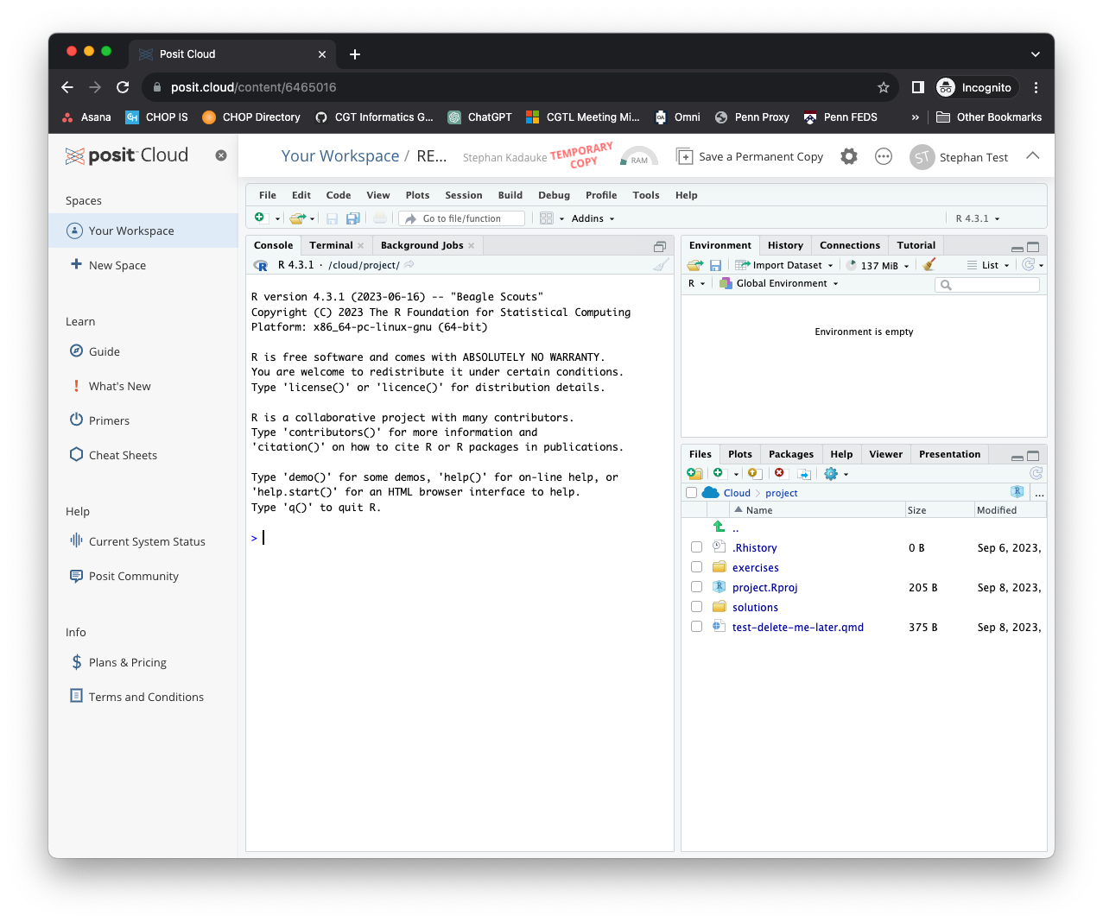
Notes:
Once you’re logged in, your screen should look like this. You can X out the left sidebar so you have more real estate on the screen.

Slide 13
Your Turn
In the Files pane on the bottom right, find the exercises folder. Click on it.
Then click on the file named 00_welcome.qmd.
A new pane will pop up on the top left with the contents of that file. Read what it says and follow the instructions to complete the exercise.
Notes:
This is our first exercise. If you’re watching this on YouTube, I suggest you hit pause and resume when you’ve finished the exercise.

Slide 14
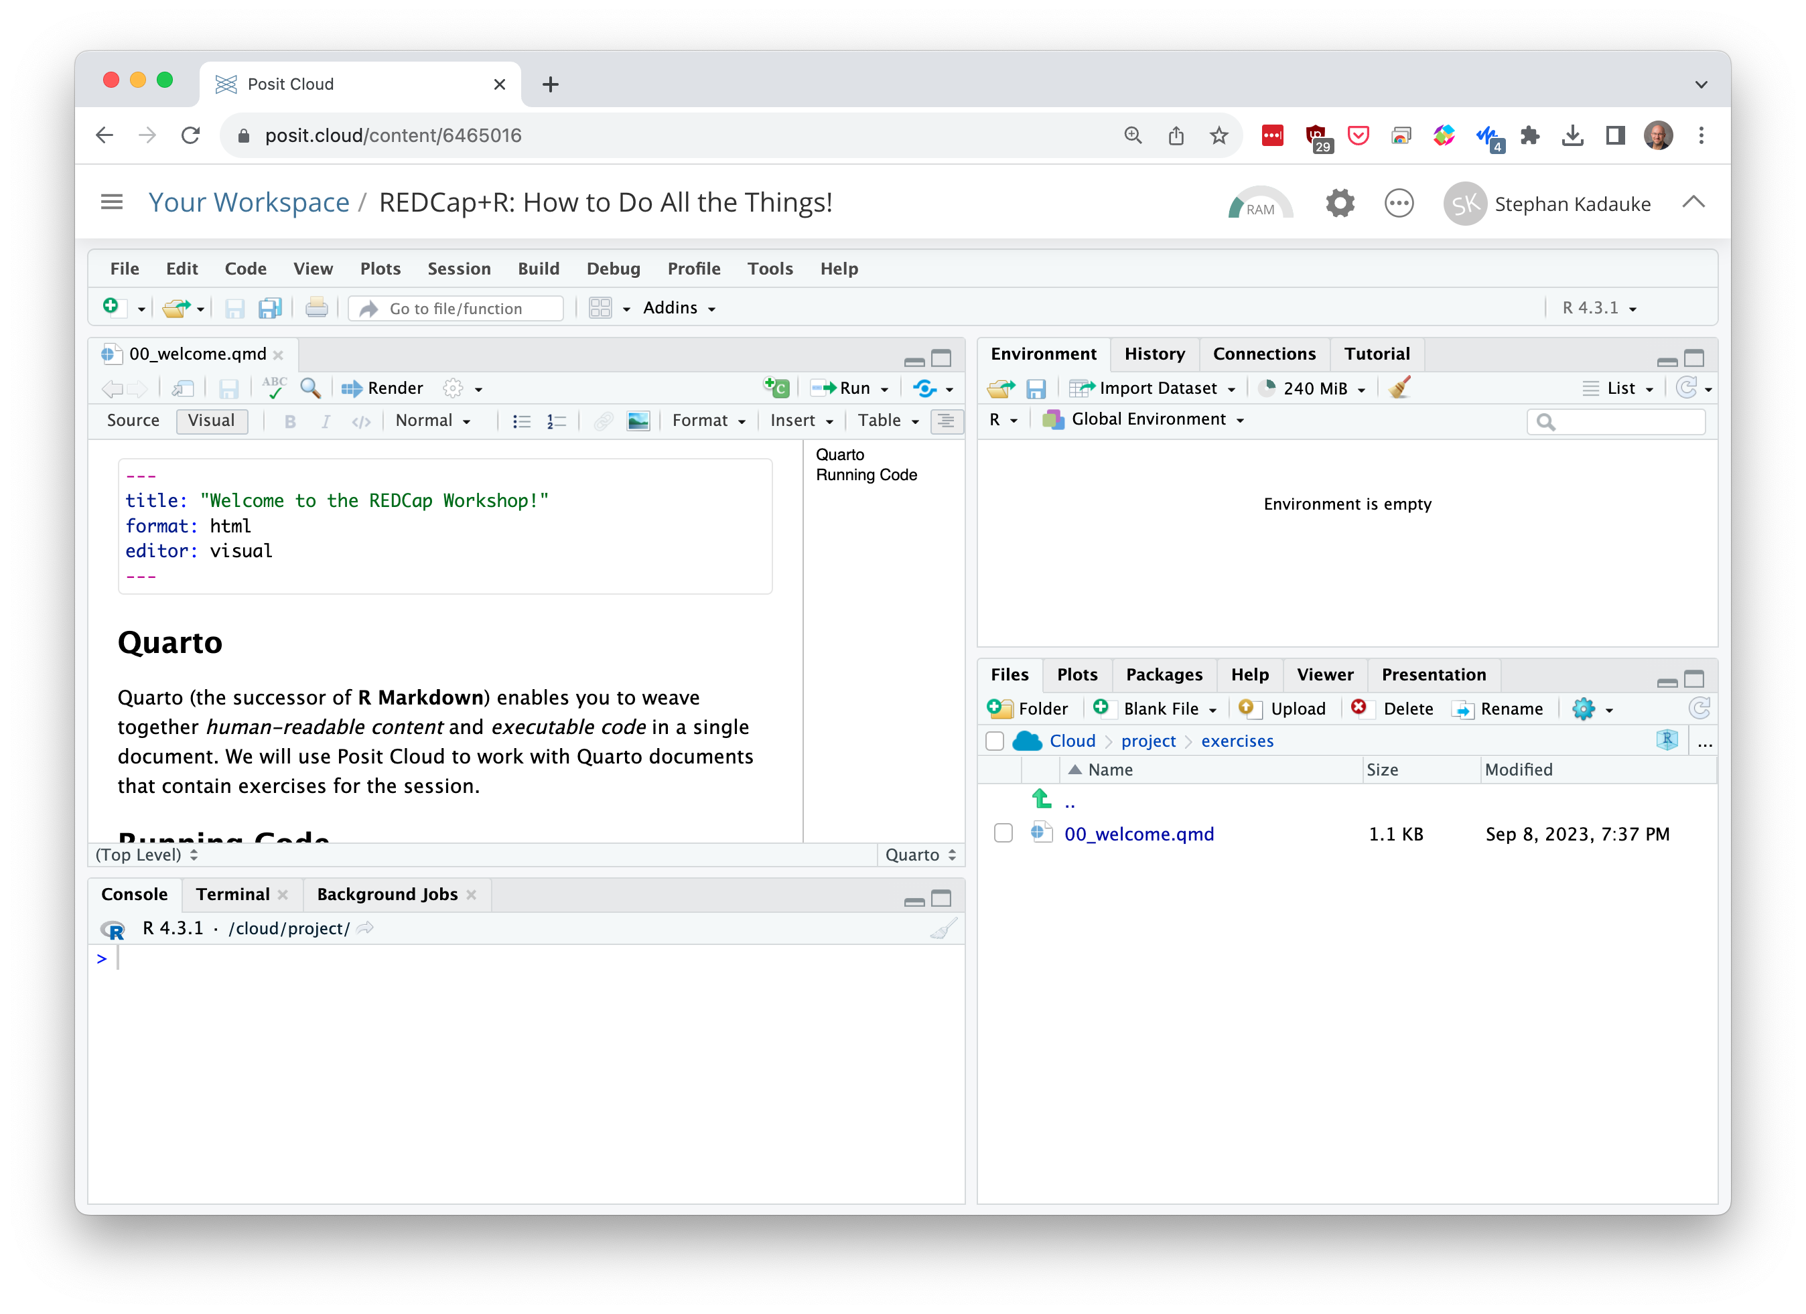
Environment
Editor
Files
(and other stuff)
Console
Notes:
Let’s talk about the RStudio or Posit IDE. Here is what it looks like.
On the top left is the editor. This is where you enter code.
On the top right is the Environment. The environment allows you to look at the data that’s loaded into R. Interacting with data in the environment tab provides some of the functionality you may be familiar with from working in Excel.
The Console is on the bottom left. You can use the console quickly run an individual R command, like install a package. As a general rule, you’ll want to minimize using the console and instead write code in the editor, even for simple things, because that’ll allow you to save your work for later which is key for reproducibility.
The pane I have labeled “Files and other stuff” has a couple of tabs. The most important one for today is the “Files,” and you’ve already explored that when you found the Quarto document with the exercise. But here’s also where help pages for R commands will show.
Now redo the exercise and run the code chunks.

Slide 15


Notes:
Let’s talk about Quarto! Quarto lets you write and share computational documents.
Quarto is a plain-text file format, which means that you can open in in a text editor and you can use it with tools like GitHub to track differences.
Quarto lets you compose documents that contain human readable content and computer code. We will use Quarto in this session and we encourage you to always use it in your future work when you do anything in R.

Slide 16
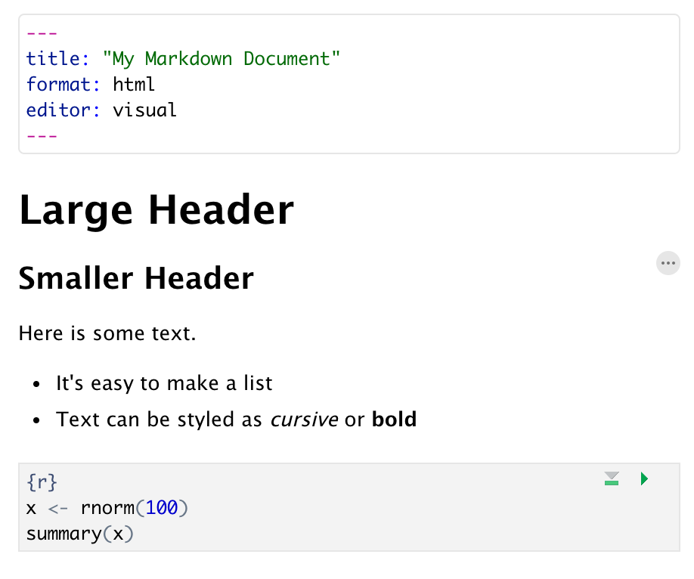
Anatomy of a Quarto Document
Header
Header
Text (with formatting)
Code chunk
Notes:
Quarto documents are composed of 3 basic building blocks.
**The first is the Header which includes information like the name of the document, the document’s author, and the desired output format. You can recognize it because it always starts with three dashes and ends with three dashes. The information written inside is YAML, which is a human readable key-value data format. For example, here we see that the title of the document will be “My Markdown Document”; and that we want the format that comes out when we render the document as HTML; and that we want to use the Visual Editor, which is the default user friendly editor of the Rstudio IDE.
**The second building block of Quarto is text. This supports a limited degree of formatting to make things more readable and nicer looking. For example, you can make large or smaller headers, and you can make bulleted and numbered lists, and you can style text as cursive and bold. You can also add hyperlinks easily.
**The final building block is code chunks. Code chunks are where the R code goes. In contrast to writing an R script which is a long piece of code, code chunks are typically quite short, which makes it easier to reason about them. While you’re working on your Quarto document, you can execute code chunks individually. Or you can render the entire document into HTML or some other presentation format, and this will run all code chunks in sequence. This may not seem like a big deal but it is: this way you get a completely reproducible data analysis.

Slide 17
10 Minute Intro to R
Notes:
For those of you who haven’t done much work with R, so I want to give here a minimal introduction with just enough detail to make sure everything that follows make more sense.

Slide 18
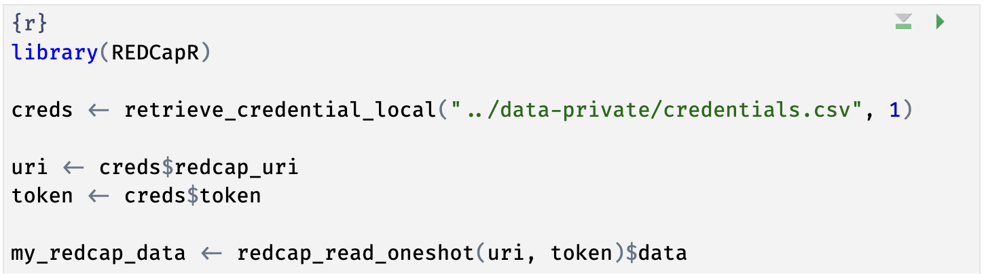
Notes:
Here’s the code chunk you just ran. This code looked up credentials to a REDCap project in a local file, and then downloaded the data from that REDCap project via the REDCap API, facilitated by the REDCapR package. If you haven’t looked at R code before, this will look very strange. In the next few slides I’m going to demystify this code.

Slide 19
The Data Analysis Pipeline
Notes:
In R, we think about the data analysis pipeline. This includes importing data, cleaning or tidying it, and then you can visualize and model it to gain insights into the data. Finally, you need to communicate these insights. One of the reasons we use the Posit/RStudio IDE and Quarto is because they provide a lot of tools to help with every one of these steps.
The first step in the data analysis pipeline is to import the data into the R environment. Data can be in the form of Excel or CSV files, or they can come from online resources. For today, we’ll focus on getting data from REDCap into R.

Slide 20
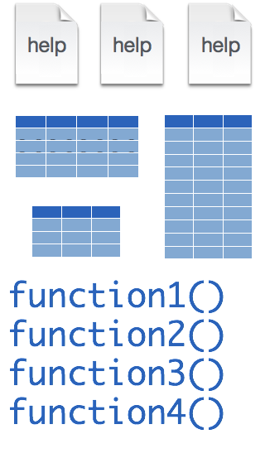
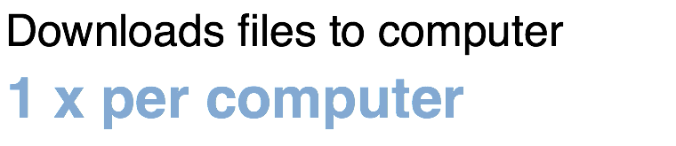
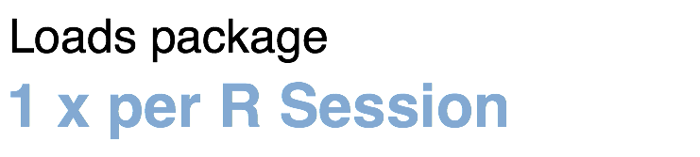
Installing and loading R packages
REDCapR
install.packages("REDCapR")
library("REDCapR")
Notes:
Much of R’s functionality comes in open-source packages. Two of these packages we’ll discuss in some detail today are the REDCapR and the REDCapTidieR packages.
At its core, a package, such as REDCapR, contains functions, documentation, and sometimes data.
Fortunately, installing packages is super easy, with the command install.packages. So let’s say you want to install a package named “REDCapR”. You go to the R Console and type install.packages(“REDCapR”).
Each package you want to use needs to be installed only once on each computer. But to actually use the functions in the package, you also need to load the package. This is done with the command “library”. So to enable all the functions in the “REDCapR” package, you type library(“REDCapR”). And in fact, library(REDCapR) was the very first line of code in the code chunk in the exercise you ran earlier.
Packages remain loaded until you quit R. So every time you start a new R session you have to load each package that you want to use again.

Slide 21
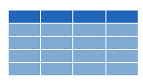


retrieve_credential_local()
creds <- retrieve_credential_local(file_name, pid)
csv
file_name.csv
REDCap PID
Notes:
Let’s look at the next line of code in that chunk. It reads, …
There is a lot of R going on in this line of code. What is does is that first calls a function named retrieve_credential_local(). This function is part of the REDCapR package. It looks at a special CSV file with REDCap credentials, such as an API token and project IDs, and this function returns some information with these REDCap credentials. This information is then stored as an object named creds in R’s memory.
Why do we use that function for this? Because this way we don’t have to hardcode credentials into our R code, which is considered bad practice. So REDCapR makes it easy for you to do the right thing!

Slide 22
object
(stores output)
function
(does stuff)
arguments
(inputs)
creds <- retrieve_credential_local(file_name, pid)
assignment operator
(“gets”)
Notes:
Let’s look a little bit closer at what happens here. First, we have retrieve_credential_local, which is a function. Functions are super important in R.
Functions take zero, one, or more inputs, and they return one output.
** The inputs are called arguments and go into parentheses. If there’s more than one argument, they get separated with commas.
** You can capture the output in an object,
** using the assignment operator. This is a smaller than sign followed by a minus or dash and is supposed to look like an arrow pointing left. In other languages this assignment operator is a single equals sign, and one of the quirks of R is that they use this arrow looking sort of assignment operator instead. People pronounce this operator as “gets” … as in creds ”gets” retrieve_credential_local “of” filename and pid.

Slide 23
uri <- creds$redcap_uri
list
creds
redcap_uri | "https://redcap.chop.edu/api/"
username | "myusername"
project_id | 1
token | "37BCFC38D45F10C47EAF4D8B97BFC32F"
comment | CAR-T cell trials
uri
"https://redcap.chop.edu/api/"
Notes:
Let’s look at the next line. This says, uri <- creds $ redcap_uri
The creds object which we just made in the previous command is a *list*. A list is an object that contains other objects. In this case, “creds” contains the following elements: redcap_uri, username, project_id, token, and comment.
The $ operator extracts an element from a list. In this case we’re extracting the redcap_uri element and then we’re storing it as an object named ‘uri’.

Slide 24
dollar operator
extracts an element from a list
uri <- creds$redcap_uri
list
a type of object that can contain
multiple arbitrary objects
Notes:
…

Slide 25
Your Turn
Write the R code to extract the element named token from the creds object and store it in an object named token.
Notes:
If you’re watching this on YouTube, write this down on a piece of paper or somewhere else and then compare your answer with the solution that will appear in just a minute.

Slide 26
token <- creds$token
Notes:
…

Slide 27
Notes:
We actually just went through the first four lines of this code chunk! Let’s look at the last line.

Slide 28
my_redcap_data <- redcap_read_oneshot(uri, token)$data
data frame (tibble)
list
... | ...
data
Notes:
This line reads, …
So we’re calling the redcap_read_oneshot() function from the REDCapR package, giving it the URI and token as inputs. But then there’s this $data thing at the end. What does that mean?
To understand this you have to first realize that the output of redcap_read_oneshot is a list. That list has a bunch of information about the REDCap database, but importantly, it has an element named “data” which contains the data from the REDCap project. We can use the function call as if we already knew that we’ll be getting back a list, and then use $data to just extract that data, and discarding all the other information of the list.
Then we use the assignment operator to store the data in an object named my_redcap_data.
** So again, the redcap_read_oneshot() function takes the URI and API token as inputs and returns a list, that contains a ”data” element.
** This data element contains a type of object that’s called a data frame or tibble. This is similar to an Excel sheet in that it has rows and columns.
** So we’re only extracting that data frame and assigning it to an object named my_redcap_data.

Slide 29
5 Minute Intro to REDCap
Notes:
For those of you who haven’t done much work with R, so I want to give here a minimal introduction with just enough detail to make sure everything that follows make more sense.

Slide 30

Recap
Quarto is a plain-text format for reproducible data analysis. Quarto documents contain text and code. You can render Quarto into HTML, PDF, and other formats.
Essential concepts in R include packages which extend the functionality of R by providing new functions; functions, which do stuff; assignment of names to objects; list objects contain other objects that can be extracted with the $ operator; and data frames or tibbles are rectangular data structures.
Notes:
And this is your 5 minute intro to R!
To recap what we covered up to this point, we looked at Quarto documents…

